Slide 1

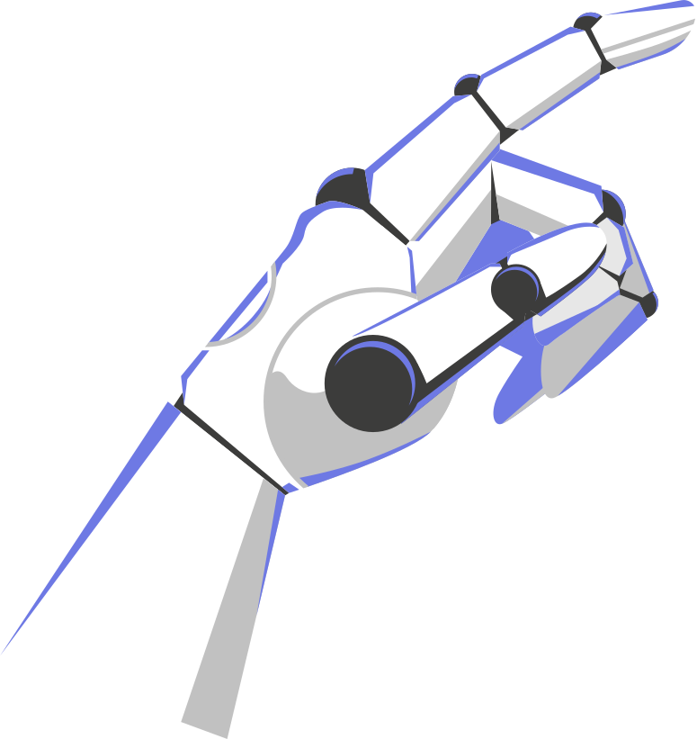
ARTIFICIAL INTELLIGENCE (AI)
PROJECT ON HAND GESTURES USING AI MODULES IN PYTHON
ARTIFICIAL INTELLIGENCE (AI)
ARTIFICIAL INTELLIGENCE (AI)
rebecca j
ARTIFICIAL INTELLIGENCE (AI)

Slide 2
01.
INTRODUCTION
/(AI)

Slide 3
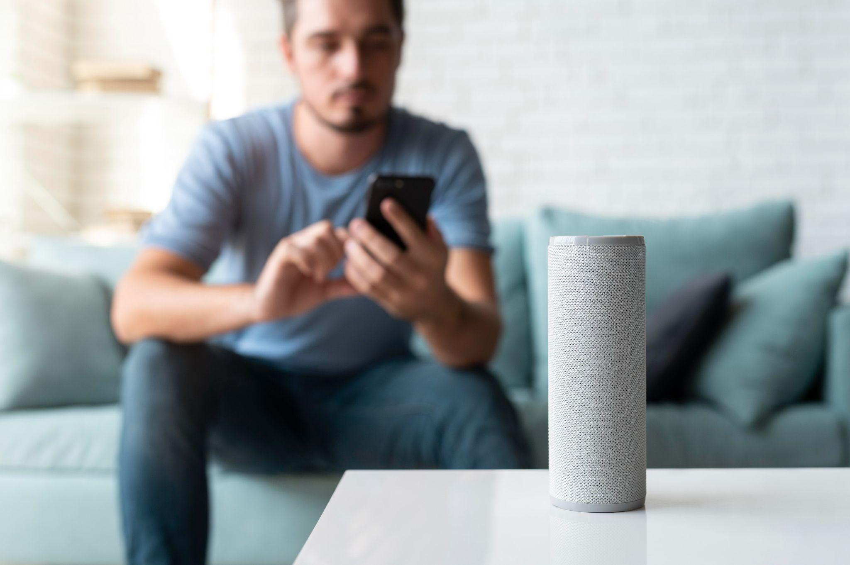

In today’s digital era, Artificial Intelligence (AI) and Computer Vision are transforming how humans interact with machines. Among the most fascinating developments in this space is gesture recognition, where computer systems understand and respond to human hand movements in real time.
Traditional presentation tools—such as keyboards, remotes, or laser pointers—require direct contact and can restrict the speaker’s natural movement, causing interruptions during lectures, meetings, or seminars. Moreover, these tools are not hygienic in multi-user environments and often require setup or batteries.
To overcome these limitations, the AI-Based Hand-Gesture Controlled Presentation System aims to provide a contactless, intuitive, and intelligent interface that allows a user to control presentation slides using hand gestures captured via webcam. The system leverages the OpenCV and cv zone. Hand Tracking Module libraries in Python to detect gestures and map them to presentation controls such as next slide, previous slide, pointer mode, drawing, and erasing.
This project not only enhances user convenience but also highlights how computer vision and AI-based tracking can be integrated into real-world applications to promote natural, human-like interaction with technology.
ARTIFICIAL INTELLIGENCE (AI)
ARTIFICIAL INTELLIGENCE (AI)

Slide 4

/(AI)
02.
OBJECTIVES OF THE PROJECT

Slide 5
1. Camera Setup and Input Capture
The webcam is initialized using OpenCV with a resolution of 1280×720.
Frames are horizontally flipped for a mirror-like viewing experience.
A green threshold line divides the frame into two zones — upper for slide control and lower for annotation.
2. Hand Detection and Landmark Extraction
ARTIFICIAL INTELLIGENCE (AI)
The system uses the Hand Detector class from cv zone.Hand Tracking Module to detect hands with high accuracy.
The module identifies 21 unique landmarks on the hand and returns their (x, y) coordinates.
The number of raised fingers is determined using the fingers Up() function.
3. Gesture Classification
Specific finger combinations are mapped to commands such as:
Moving between slides.
Annotating directly on the current slide.
Erasing drawings.
Displaying a pointer circle for highlighting.
These gestures are interpreted dynamically as the user moves their hand within the camera frame.

Slide 6
4. Pointer Smoothing and Motion Interpolation
To avoid sudden pointer jumps, the system applies a smoothing factor.
The current pointer location is calculated as:
x_{new} = x_{prev} + \frac{(x_{raw} - x_{prev})}{smoothing}
ARTIFICIAL INTELLIGENCE (AI)
5. Slide Loading and Management
Slides are stored in a folder and read sequentially using os.listdir().
The variable imgNumber keeps track of the current slide index.
Annotated drawings are stored in arrays and redrawn with cv2.line() on every iteration.
6. Output Visualization
The live webcam feed is resized and embedded into the top-right corner of the active presentation slide.
The final output combines both windows, providing a real-time interactive view.

Slide 7
/(AI)
03.
METHODOLOGY

Slide 8
1. Develop a Real-Time Gesture Recognition System
2. Implement Accurate Hand and Finger Detection
3. Map Recognized Gestures to Presentation Controls
Use cv zone. Hand Tracking Module to extract 21 hand landmarks and detect finger positions.
Ensure high detection confidence (≥ 0.8) to reduce false recognition.
Define a small, easy-to-remember set of gestures for performing core presentation tasks such as moving to the next or previous slide, enabling the pointer, drawing annotations, or erasing drawings.
Ensure that each gesture is unique and comfortably distinguishable to prevent overlap or false recognition.
Capture live video frames from a webcam.
Process images in real time to detect and track a single hand.
/(AI)/(AI)/
/(AI)/(AI)/

Slide 9
4. Ensure Smooth and Stable Pointer Movement
5. Design a Simple, User-Friendly Interface
6. Provide a Low-Cost and Portable Solution
Apply interpolation and a smoothing factor to reduce jitter and ensure stable pointer tracking.
Maintain natural movement transitions using a smoothing constant.
Display both the presentation slide and live camera feed within one window.
Use threshold lines to differentiate between navigation and annotation zones.
Utilize freely available Python libraries (OpenCV, NumPy, cvzone).
Operate efficiently on standard laptop webcams without external sensors.
/(AI)/(AI)/
/(AI)/(AI)/

Slide 10

/(AI)
04.
RESULT & DISCUSSION

Slide 11
The AI-based gesture control system was tested under various lighting conditions and camera positions. It achieved high accuracy and stability in recognizing gestures, provided the background was not cluttered. The transition between slides was instantaneous, and drawing operations were fluid.
Users found the experience intuitive—raising one finger to draw or two fingers to point felt natural and easy to adapt. The pointer smoothing made the cursor movement appear consistent and professional, preventing abrupt jumps.
Additionally, the integration of a live webcam feed within the presentation enhanced engagement, as the presenter remained visible while interacting with the slides.
However, some limitations were observed: gesture detection was slightly inconsistent when lighting was dim or the background color closely matched skin tone. Multi-hand gestures occasionally caused overlap in recognition, which could be improved with further tuning or deep-learning-based classification models.
Overall, the system performed effectively, meeting all project objectives and successfully demonstrating the potential of real-time AI-driven gesture control.
ARTIFICIAL INTELLIGENCE (AI)

Slide 12
05.
CONCLUSION
/(AI)

Slide 13
The AI-Based Hand-Gesture Controlled Presentation System is a practical and innovative solution that merges Artificial Intelligence with Computer Vision to deliver a contactless method of presentation control. By detecting and interpreting hand gestures, the system eliminates the need for external remotes or physical devices, allowing a smoother and more interactive presentation experience.
This project highlights the feasibility of developing intelligent, low-cost interfaces using Python and open-source libraries. In the future, this system can be further expanded with multi-hand recognition, custom gesture training using neural networks, voice-command integration, and gesture-based media or volume control.
Through this project, the potential of human–computer interaction has been demonstrated—creating an intelligent system that reacts naturally to the presenter’s movements and redefines the way we deliver digital content.
ARTIFICIAL INTELLIGENCE (AI)
ARTIFICIAL INTELLIGENCE (AI)

Slide 14
ARTIFICIAL INTELLIGENCE (AI)
THANK
YOU
/(AI)/(AI)/

